Slide 1
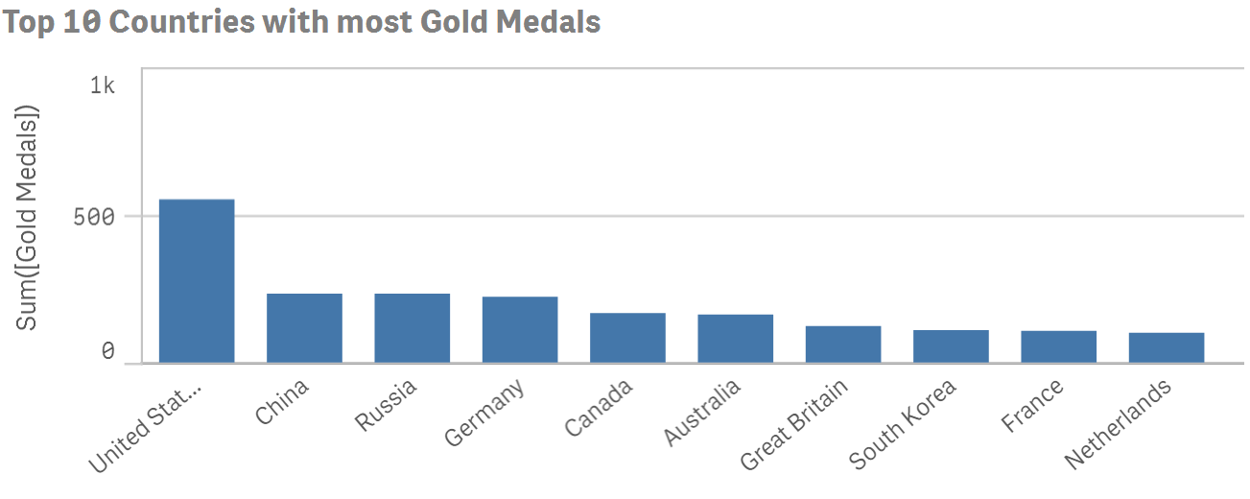
Countries securing most Gold Medals in Olympics

Slide 2
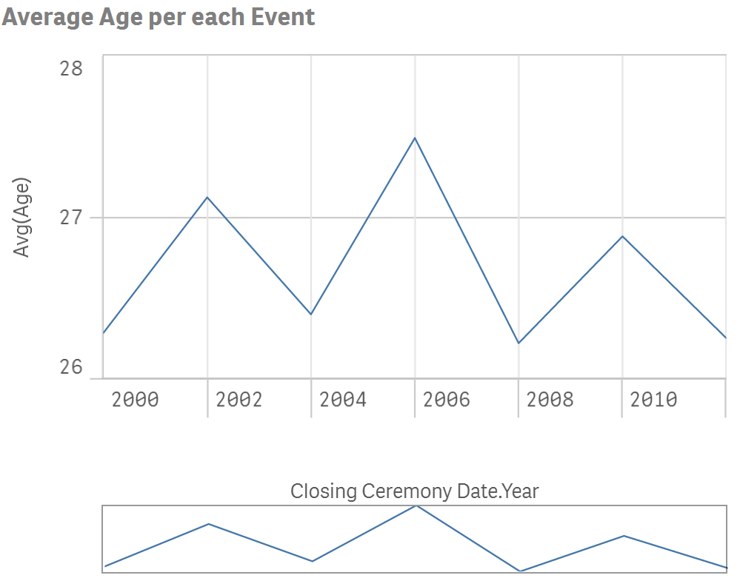
Average Age of athletes participating in each Event

Slide 3
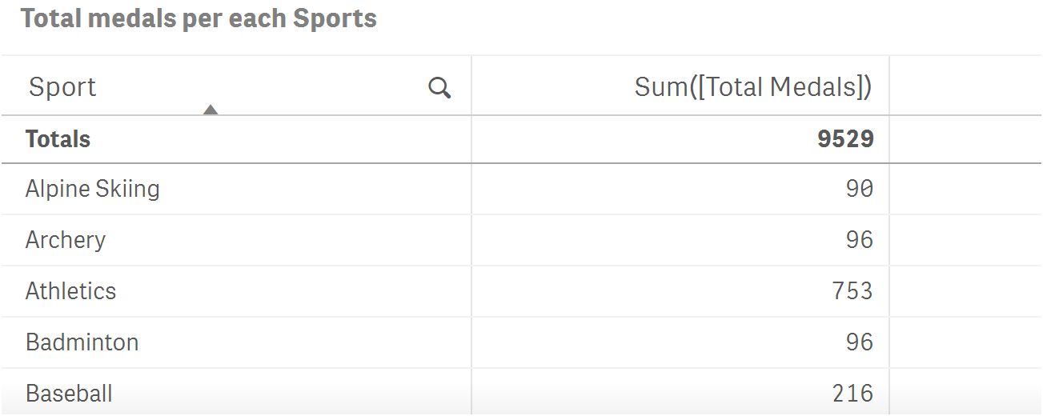
Number of medals earned in each Sports

Slide 4
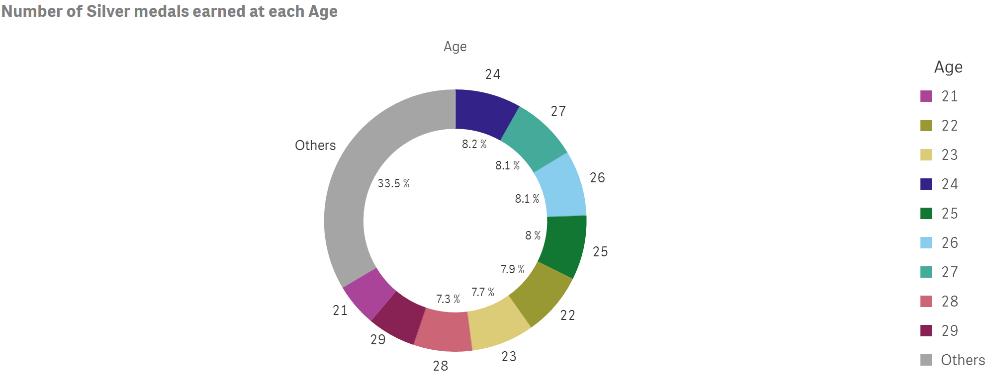
Age at which people earn more Silver medals

